Slide 1


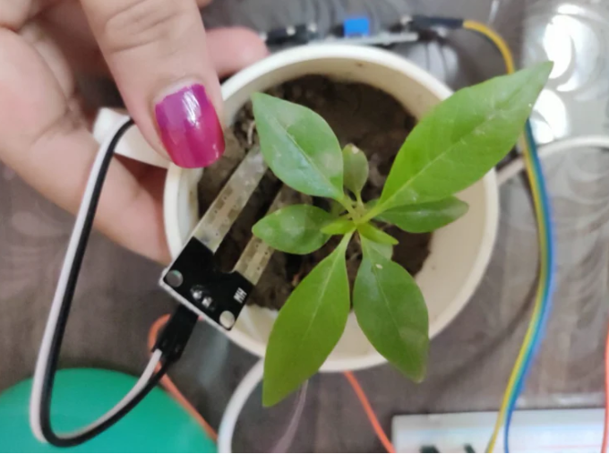
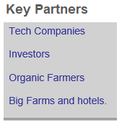
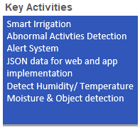
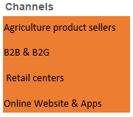
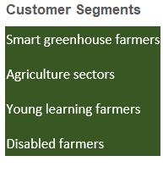
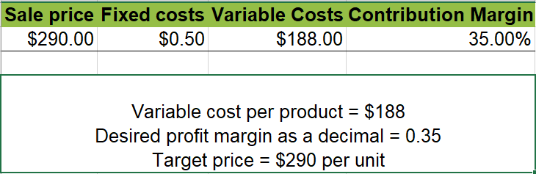
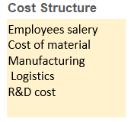
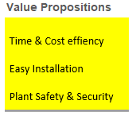
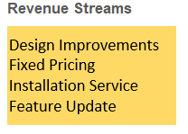
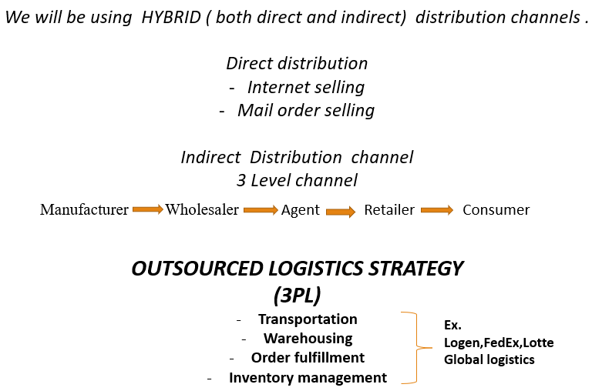
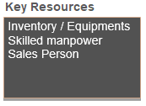
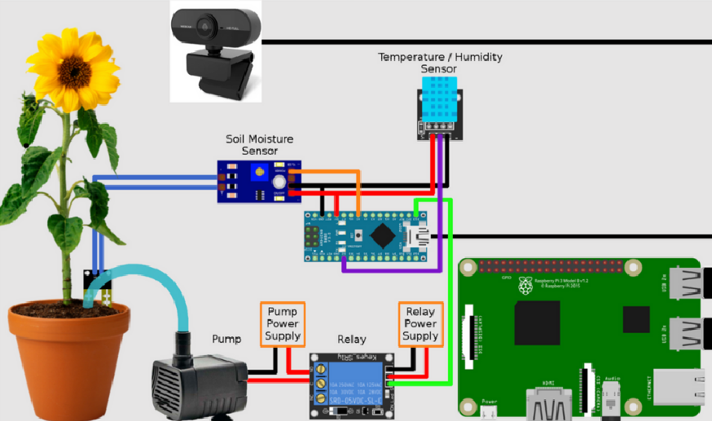
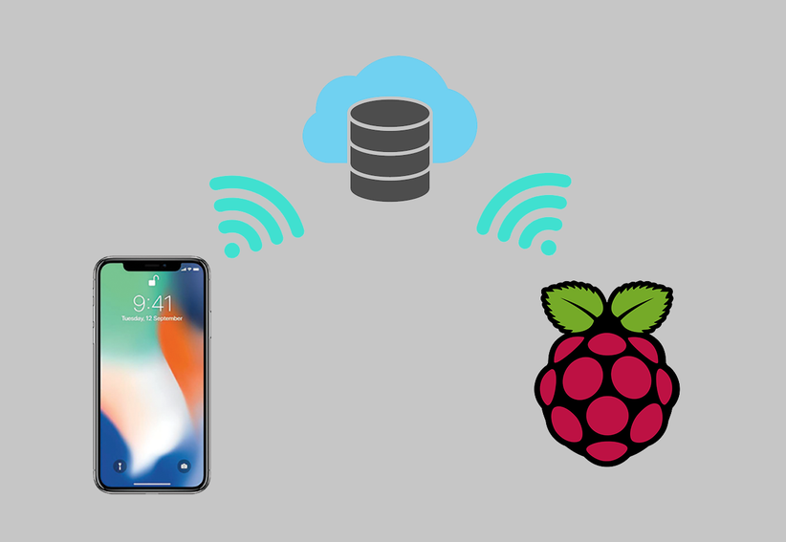
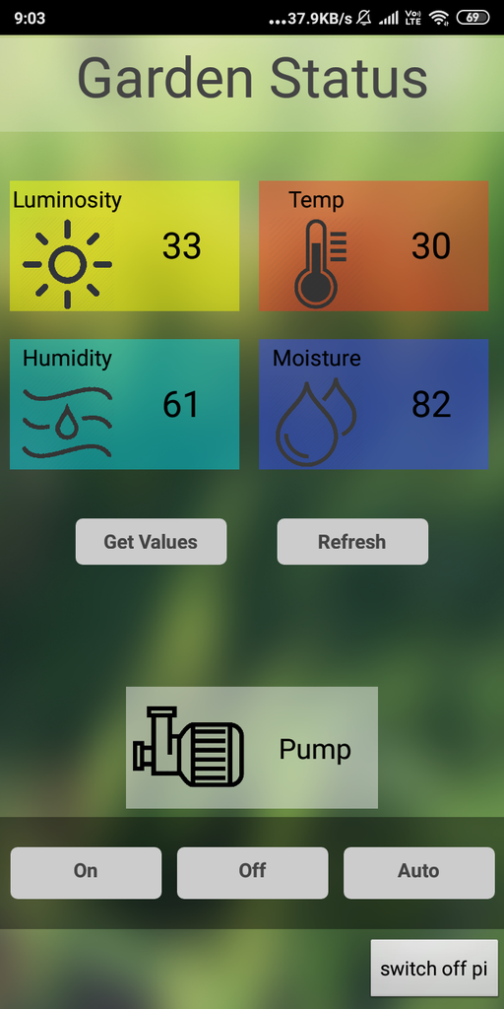
2023-1 Capstone Project
Iot in agriculture: Smart plant care system
12194824 Ritik Deuja
12200306 Asadbek Khoshmov
12200311Azizbek Akhmadov
12200334 Jaloliddin Abdullajonov
12194938 Babina Tamang
12194927 Jasurbek Tulkinhujaev
12184750 Ulugbek Oripov
12200341 Shokhrukh Khayitov
Team-6
BCM & Product
Price & Distribution
Process Design of the Product
Promotion, Technology& Innovation
Target market:
Agriculture industry
Home Gardeners/urban dwellers
Busy farmers/ Plant Enthusiasts
Prefer convenient and practical products
in farming.
Marketing strategy:
Content marketing: Developing a company website
and creating mobile applications for sharing blogs and uploading educational videos on YouTube.
Social media marketing: Creating Engaging Content and Running Targeted Ads
B2B marketing: Engagement through live demonstrations, lectures, active participation in EXPO events, and seminars.
Highlighting the benefits of IoT in agriculture: Provide farmers and growers with increased productivity, improved resource management, and accurate data collection.
Research Method & Process
START
STAGE | DESCRIPTIONS
Literature Review | Research conducted on smart greenhouse technologies and Raspberry Pi-based solutions to find areas for improvement.
Requirements Analysis | The desired functionalities and necessary hardware components for the smart plant care system were thoroughly analyzed.
System Design and Architecture | A collaborative effort resulted in the design of a modular system, including the selection of appropriate sensors, integration of Raspberry Pi, establishment of communication protocols, development of data processing algorithms, and creation of a smartphone application.
Prototype Development and Implementation | A functional prototype of the smart plant care system was created, combining hardware and software elements. It was tested in an actual greenhouse setting.
Data Collection and Analysis | Relevant data was collected to evaluate the system's performance in areas such as people counting, plant monitoring, face detection, and disease detection. The data was analyzed to assess accuracy, efficiency, and user-friendliness.
System Evaluation and Comparison | The proposed system was evaluated by comparing it to existing Raspberry Pi-based solutions. Strengths, weaknesses, and potential integration opportunities within greenhouse management practices were identified.
Opportunities and Market Analysis | Potential market opportunities for the developed smart plant care system were explored, considering its unique features, benefits, and possible applications. A marketing strategy was devised to promote the system's adoption.
Initialize Raspberry Pi
Research Method
Connect Sensors (i.e., Temperature, Humidity, Soil moisture, Light )
Connect Actuators (Fan, heater, dehumidifier, humidifier, water pump, grow lights)
Read & Analyze Sensor Data
Send control signals to Actuators.
Record and Display sensor Data (i.e., Website or mobile app)
Smart plant care system can remote monitoring and care of plants from anywhere.
Intelligent insights and recommendations for optimal plant care.
Automation for effortless maintenance of plants.
Check for any alerts or notifications! (i.e., low water level, abnormal sensor readings)
Activate Warning system via Sound
Wait for a set amount of time (15 min)
Through conducting thorough research, analyzing requirements, designing a modular system, developing a prototype, collecting and analyzing data, evaluating the system, and assessing market opportunities, an advanced and marketable Raspberry Pi-based smart plant care system for greenhouse applications was created.
Flowchart representing Working Mechanism of sensors/actuators
Summary, Limitations & Recommendations
Sensors
Image Processing/OpenCR
Recommendations:
Sensor Diversity: Exploring the integration of additional sensors such as temperature and light sensors can provide a more comprehensive understanding of plant conditions and improve the accuracy of plant care decisions.
Mobile Application Integration: Developing a user-friendly mobile application that allows remote monitoring and control of the smart plant care system would enhance accessibility and convenience for users.
Data Analytics and Machine Learning: Implementing advanced data analytics and machine learning algorithms can enable predictive analysis and customized plant care recommendations, enhancing the effectiveness of the system.
Temperature
Humidity
Soil moisture
Light Intensity
Summary: The goal of project aims to develop a comprehensive solution for optimizing plant care by utilizing a moisture sensor, Raspberry Pi, and a camera. The system detects humidity levels through the moisture sensor and performs data processing using Raspberry Pi. Additionally, the camera captures visual information for plant health analysis. The project focuses on automating watering based on sensor readings and visual assessment to promote healthy plant growth.
START
Sensor Used:
Soil moisture sensor
Temperature/ Humidity Sensor
Control software
Raspberry Pi (Wi-Fi enabled)
Actuators
Sensor data collection
Camera
Water pumps
Fans
Lights
Data processing
Process
Hardware & Software Architecture
Limitations:
Sensor Precision: The moisture sensor's accuracy in measuring humidity levels may be limited.
Visual Analysis Challenges: Relying solely on camera visuals for plant health assessment may have limitations. To overcome this, incorporating advanced image processing techniques can improve accuracy and enable more comprehensive plant health analysis.
Power and Connectivity Issues
Is soil moisture below threshold?
Is temperature too high?
YES
Activate cooling system.
No
The smart plant care system utilizes Raspberry Pi, a camera, and a moisture sensor. Raspberry Pi serves as the central processor, while the camera captures plant visuals, and the moisture sensor measures soil moisture levels. The software integrates with Raspberry Pi, enabling data analysis and control algorithms. This comprehensive architecture optimizes plant care routines, utilizing technology for informed decision-making and automation.
YES
No
Activate water pump.
END

